Slide 1
Social Stratification

Slide 2
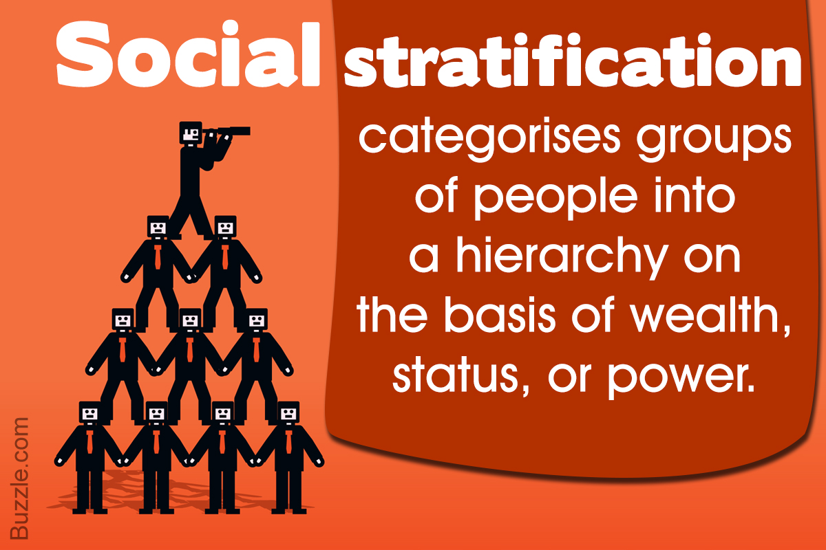

Slide 3
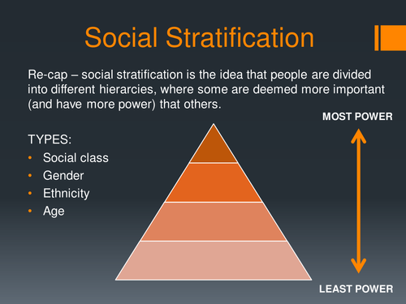

Slide 4
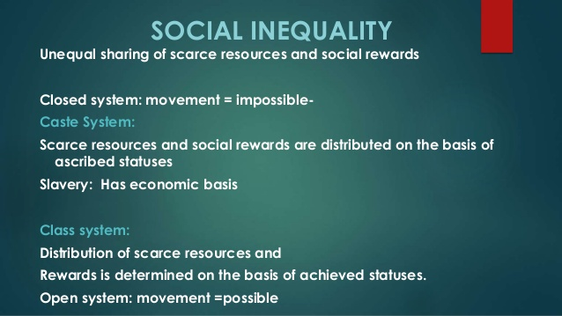

Slide 5
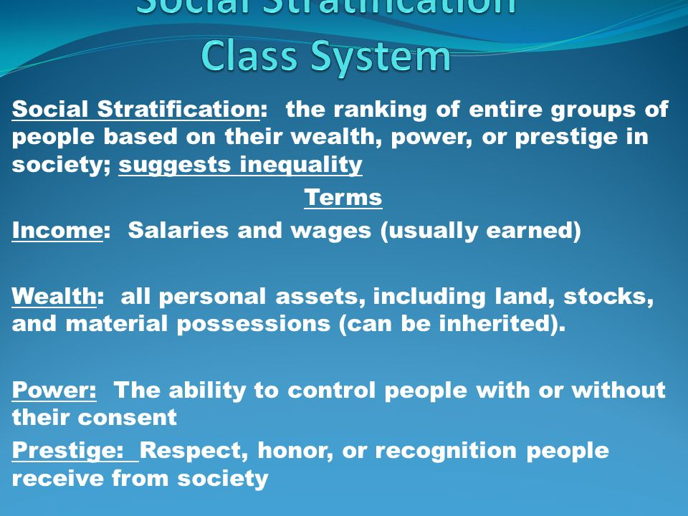

Slide 6
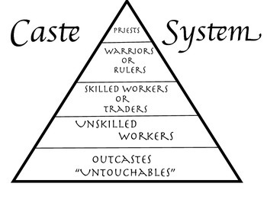
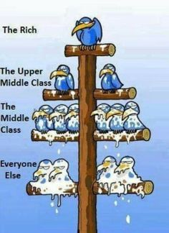
Caste system
Class system

Slide 7
Summary
Group is a collection of people having same sense of identity. Groups have multiple functions depend on size of group. If group size is small, group act as expressive function which is long-lasting i.e. family, if group is of large size, group act as instrumental functions which is short-term and task-oriented i.e. organizations, institutes etc.
Stratification is hierarchal division of people in society on basis of wealth, power, income, gender, race and ethnicity.
Caste system is closed system.
Class system is open system.
Mobility and movement is possible only in open system.

